Slide 1
IoT With Arduino
Nitish Kumar Jha
GIS 2018 (Android Basic Nanodegree Track)

Slide 2
CONTENT
What is IoT? Why we care about IoT?
How Big IoT is?
IoT in Day to Day Life and Where To Start?
Challenges/Privacy with IoT
Arduino
Overview Of Home Automation System

Slide 3
"Think about some of the pieces of technology or up-and-coming topics that, maybe five years ago, we thought had nothing to do with us. Those of us who ignored them quickly fell behind the curve."

Slide 4
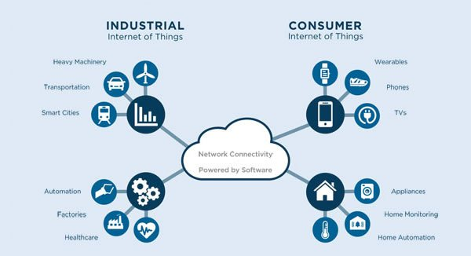
What is IoT? Why we Care?
Internet Of People
Internet of Things : coined by Kevin Ashton in year 1999.

Slide 5
Contt…
Refers to connectivity amongst various things and with the internet.
Things here refer to a physical object containing an embedded system(electronic circuit) within it.
Things with ability to communicate with other things or with the internet can be termed as an IOT device.

Slide 6
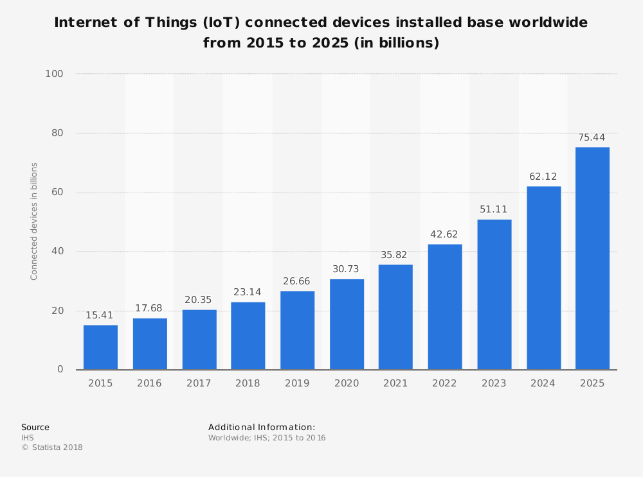
Contt..
The IoT generates massive amounts of data, and cloud computing provides a pathway for that data to travel to its destination.

Slide 7
Case 1 : beverage distribution company Diageo wanted to find a unique (and digital way) to connect sons and daughters to connect with their dads on Father's Day, the company connected 100,000 bottles of whiskey -- real, drink-filled, glass bottles -- to the internet. The reason? So that these 100,000 dads could connect to receive a personalized video message from their sons or daughters.

Slide 8
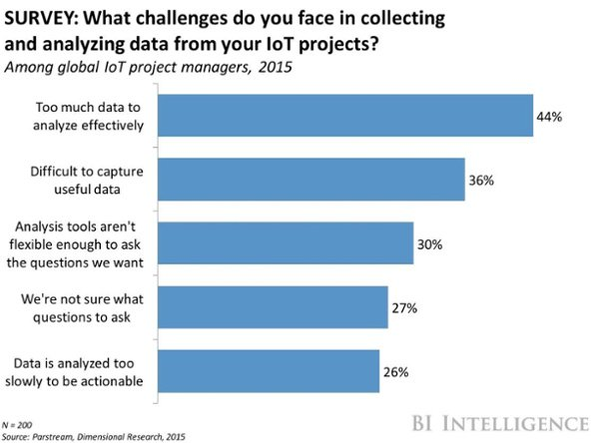
Where To Start With IoT 1) Pay attention to the Problems available to you. 2) Anticipate the problems to Provide Solution. 3) Start brainstorming, and look for inspiration in history.

Slide 9
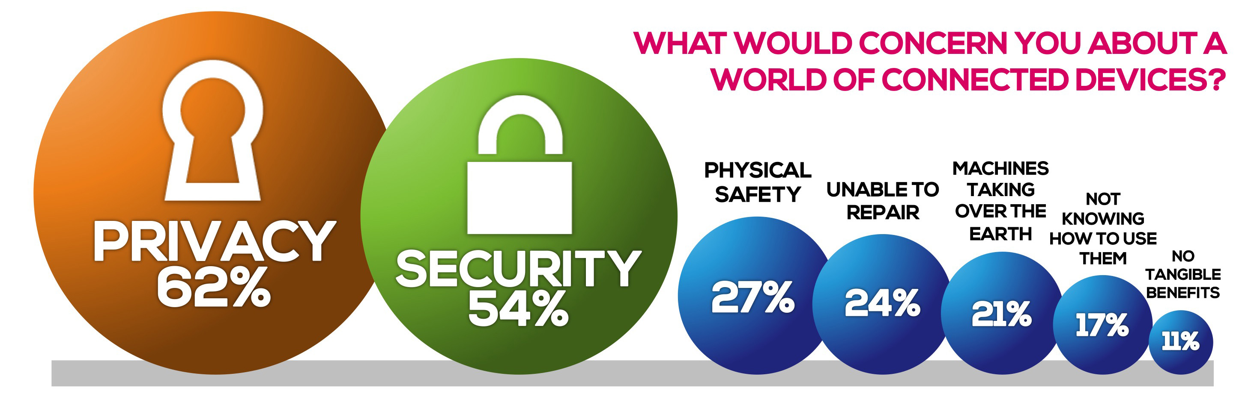
Privacy / Security

Slide 10
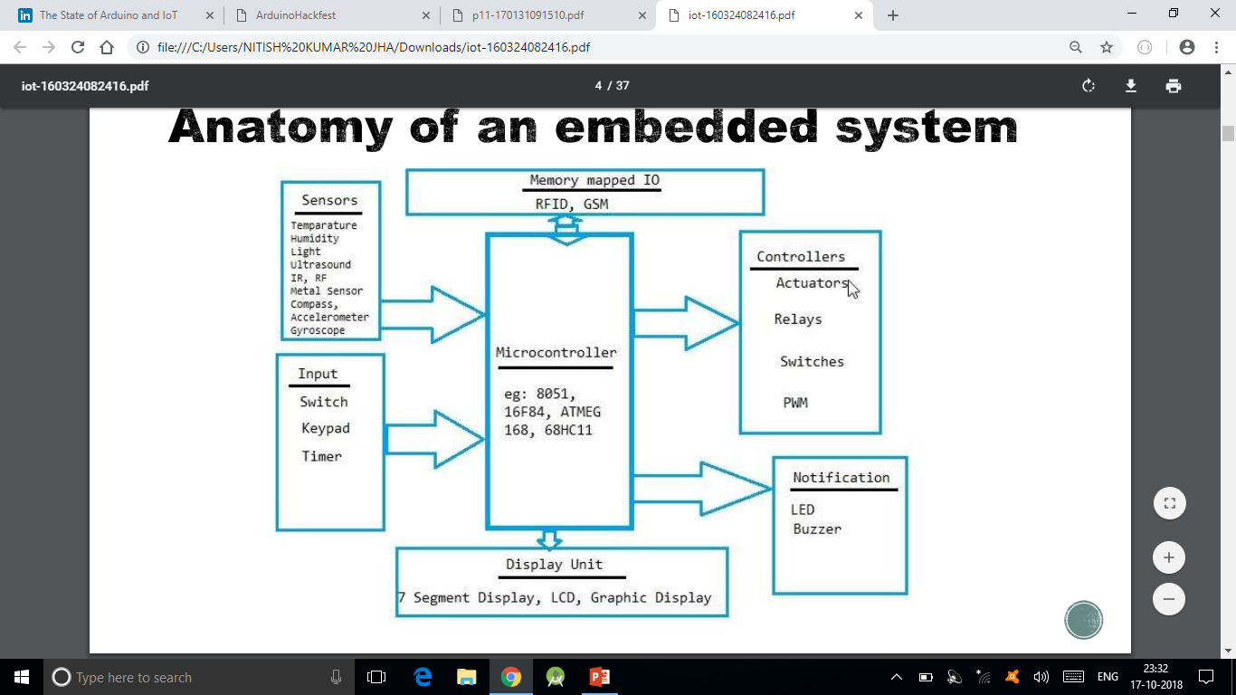
Arduino : Start With IoT

Slide 11
WHY ARDUINO ??
Simplicity – easy to interface & simple coding
Robustness – turn on and off at any time, there is no shutdown of operating system
Low power consumption - easily powered
from battery
Cheaper
Suitable for electronic products

Slide 12
ARDUINO
Microcontroller based physical computing
platform.
Does not need any OS
Need to create sketch in the arduino
language(just like C)
Inbuilt ADC.

Slide 13
Arduino Board(s)
Is an open-source electronics platform based on easy to use hardware and software.
Typically, these boards are microcontroller boards which means that it has no OS running on top of it and will be able to run a minimalistic program.
Arduino board can be connected to a PC through USB port.
Programs a.k.a sketches are written using Arduino Language, which is merely a set of C/C++ functions.
Arduino Software(IDE): It is a text editor which can be used to write sketches and enables us to upload sketches onto the Arduino board. Arduino IDE is cross platform and can run on either Windows/Mac/Linux as it is Java based.
Arduino shields are smaller add-on boards that connect to the Arduino board to perform functions such as sensing heat, light, GPS tracking, etc..
Used if our application is core hardware centric(using sensors and actuat

Slide 14
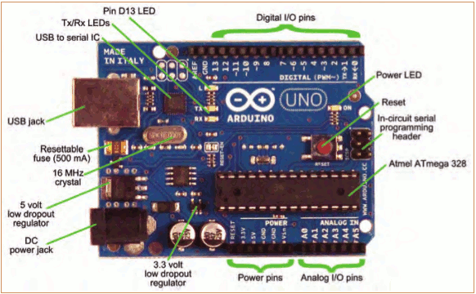
Topic 1: Meet Arduino Uno

Slide 15
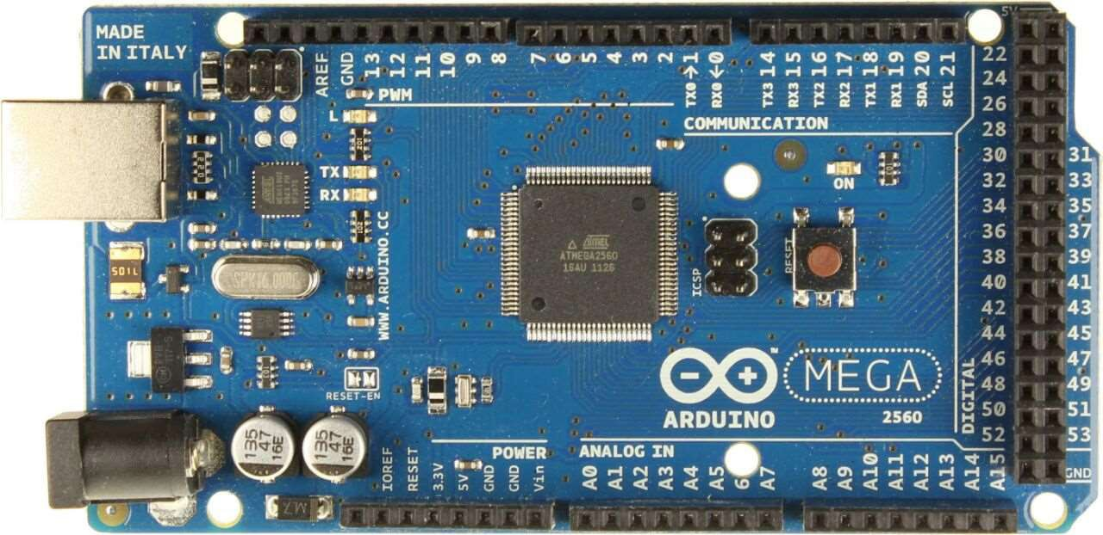
ARDUINO MEGA

Slide 16
FEATURES
Microcontroller ATmega2560
Operating Voltage 5V
Input Voltage (recommended) 7-12V
Input Voltage (limits) 6-20V
Digital I/O Pins 54 (of which 15 provide PWM output)
Analog Input Pins 16

Slide 17
DC Current per I/O Pin 40 mA
DC Current for 3.3V Pin 50 mA
Flash Memory 128 KB of which 4 KB used by bootloader
SRAM 8 KB
EEPROM 4 KB
Clock Speed 16 MHz

Slide 18
Getting Started
Check out: http://arduino.cc/en/Guide/HomePage
Download & install the Arduino environment (IDE) (not needed in lab)
Connect the board to your computer via the USB cable
If needed, install the drivers (not needed in lab)
Launch the Arduino IDE
Select your board
Select your serial port
Open the blink example
Upload the program

Slide 19
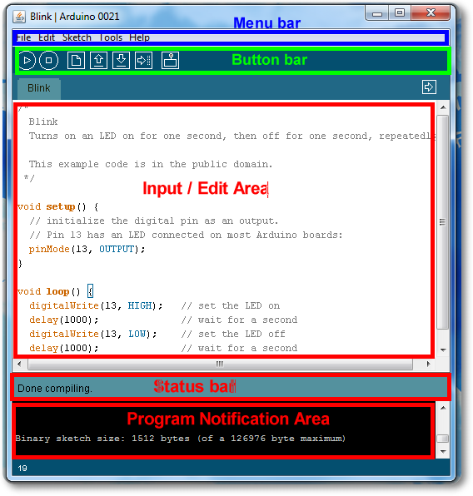
Arduino IDE
See: http://arduino.cc/en/Guide/Environment for more information

Slide 20
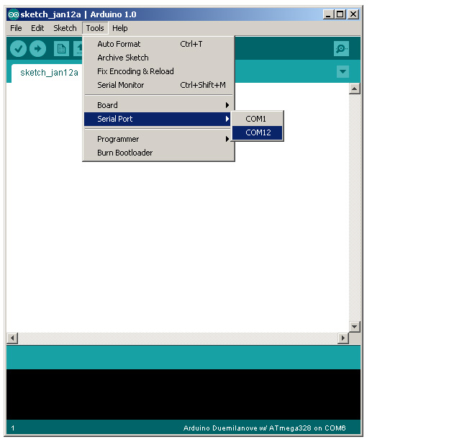
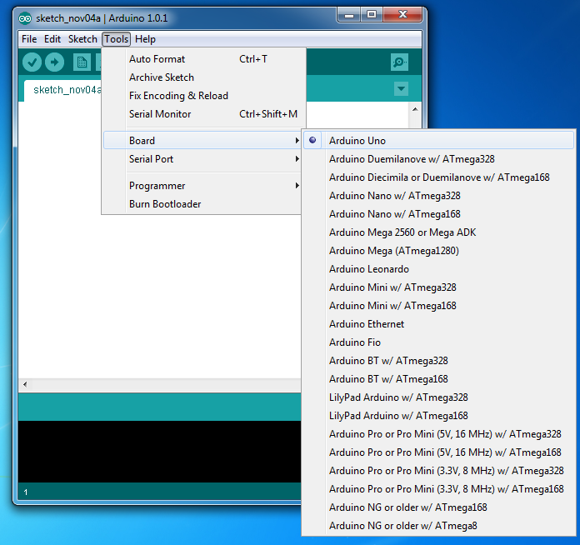
Select Serial Port and Board

Slide 21
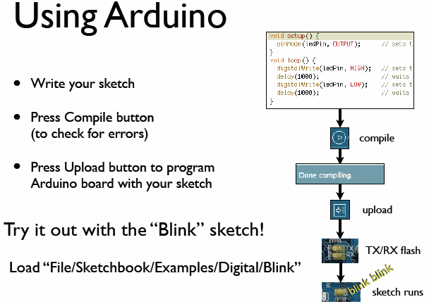
todbot.com/blog/bionicarduino

Slide 22
Some Commands
Serial.begin()
- e.g., Serial.begin(9600)
Serial.print() or Serial.println()
- e.g., Serial.print(value)
Serial.read()
Serial.available()
Serial.write()
Serial.parseInt()
Example Program

Slide 23
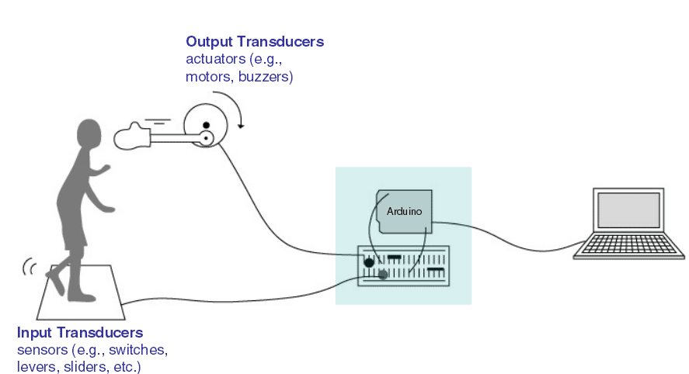
Input/Output
Image from Theory and Practice of Tangible User Interfaces at UC Berkley

Slide 24
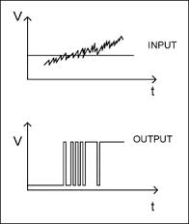
Topic 2: Digital Input/Output
1
Digital IO is binary valued—it’s either on or off, 1 or 0
Internally, all microprocessors are digital, why?
0

Slide 25
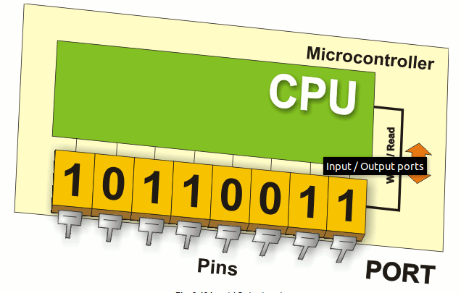
Arduino Digital I/0
www.mikroe.com/chapters/view/1
pinMode(pin, mode)
Sets pin to either INPUT or OUTPUT
digitalRead(pin)
Reads HIGH or LOW from a pin
digitalWrite(pin, value)
Writes HIGH or LOW to a pin
Electronic stuff
Output pins can provide 40 mA of current
Writing HIGH to an input pin installs a 20KΩ pullup
Notes:
25

Slide 26
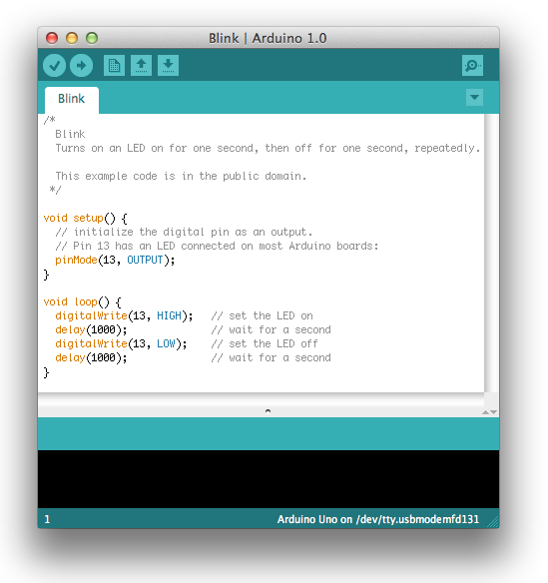
Our First Program

Slide 27
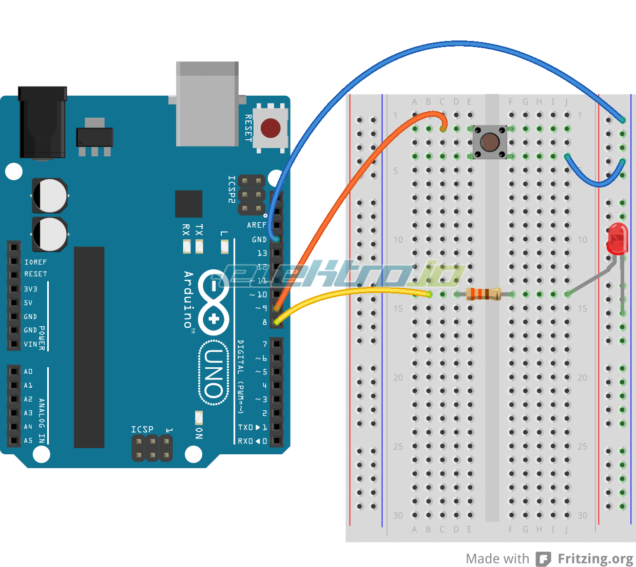
Digital IO
Use a push-button to turn ON/Off LED

Slide 28
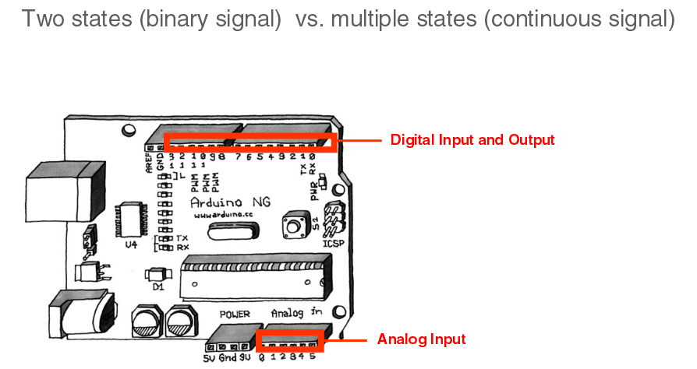
IO Pins
Image from Theory and Practice of Tangible User Interfaces at UC Berkley

Slide 29
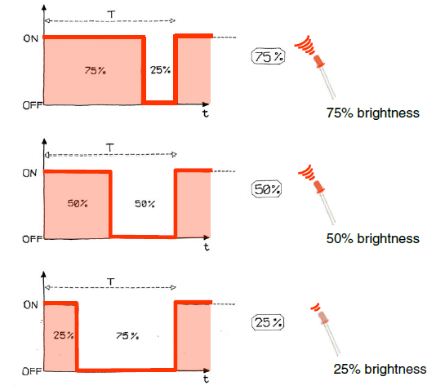
Pulse Width Modulation
Can’t use digital pins to directly supply say 2.5V, but can pulse the output on and off really fast to produce the same effect
The on-off pulsing happens so quickly, the connected output device “sees” the result as a reduction in the voltage
Image from Theory and Practice of Tangible User Interfaces at UC Berkley

Slide 30
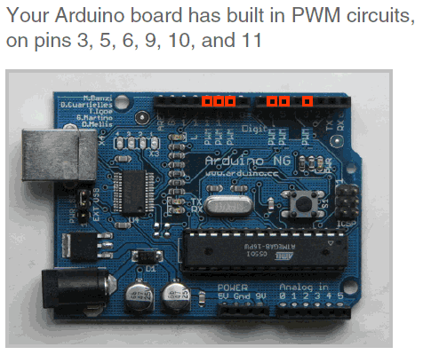
PMW Pins
Command: analogWrite(pin,value)
value is duty cycle: between 0 and 255
Examples:
analogWrite(9, 128)
for a 50% duty cycle
analogWrite(11, 64)
for a 25% duty cycle
Image from Theory and Practice of Tangible User Interfaces at UC Berkley

Slide 31
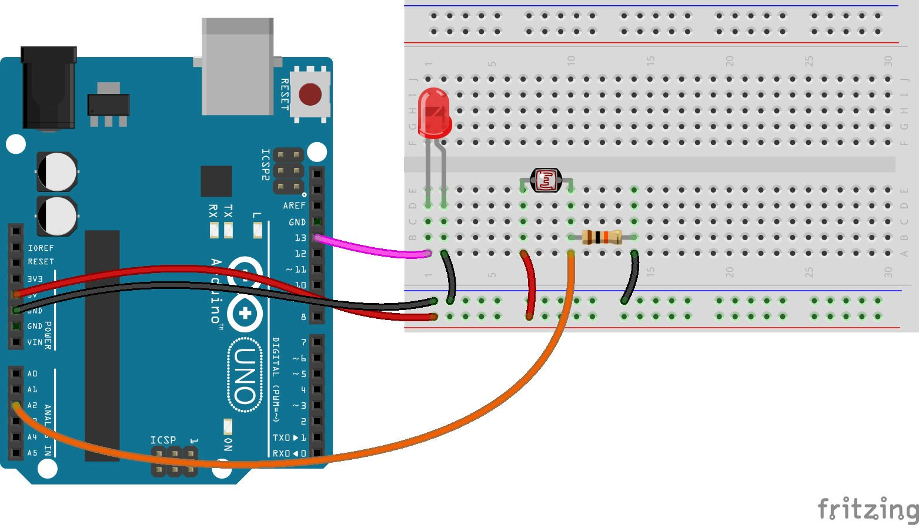
Photocell

Slide 32
WHY IoT ??
Generate, collect, process and use acquired
information to make better decisions.
Things could be anything. Physical or virtual.
Things can be interact each other smartly.
Create a social network of sensors

Slide 33
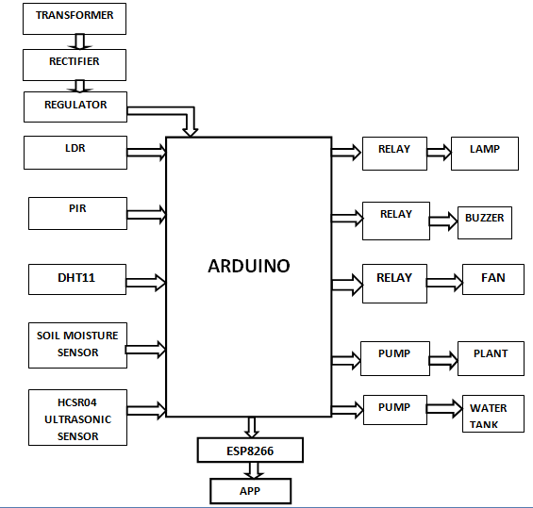
BLOCK DIAGRAM

Slide 34
BLOCK DIAGRAM DESCRIPTION
Transformer, rectifier and regulator is used to
provide power supply
Light is sensed by using LDR and control the
lamp through relay
Motion is detected by using PIR and security is provided by making alarm through buzzer.
Temperature & humidity can be sensed and
can be used to control fan using DHT11..

Slide 35
Water level in tanks or even having a check on
floods can be done using ultrasonic sensor.
Plant watering is made simpler in this project by measuring moisture content on soil and watering accordingly.

Slide 36
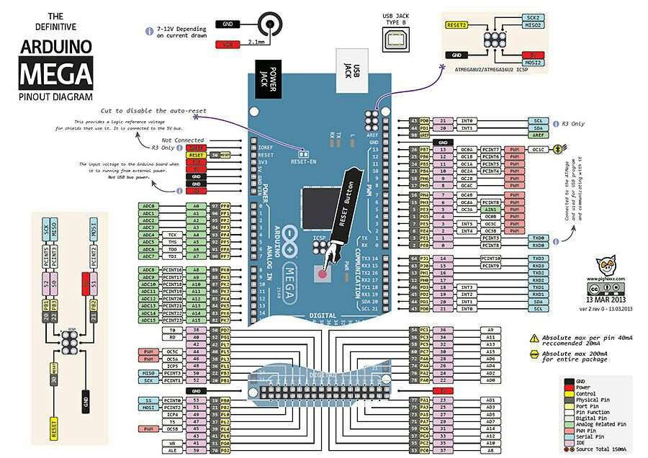

Slide 37
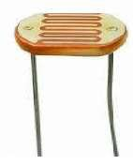
LDR
Used to sense light
Photocell is used
Resistance is inversely proportional to light
falling on it.
Lightly doped for required conductivity

Slide 38
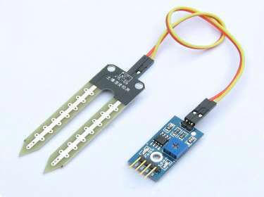
SOIL MOISTURE SENSOR
When soil having water shortage, the sensor
o/p will be high. Otherwise low.
Triple output mode. Digital o/p, analog o/p
and serial o/p
Adjustable sensitivity

Slide 39
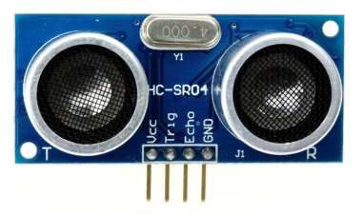
HCSR04
Provides 2cm-4m non contact measurement.
Module include transmitter, receiver and
control circuit.
Test distance=(high level time*velocity of sound)/2.
Plane should be smooth for accurate measuring

Slide 40
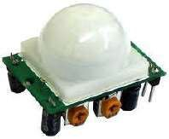
PIR
Used for motion detection
Passive infrared sensor
3pins- gnd, vcc, o/p
o/p pin will be high when motion detected
Sensitivity 20 feet range
(

Slide 41
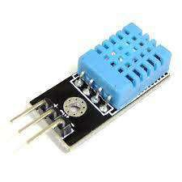
DHT11
Humidity+Temperature sensor
Measurement range: 20-90%RH,0-50’C
Sends data in form of pulses train of specific
time period.

Slide 42
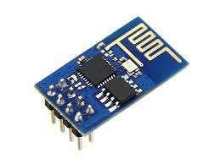
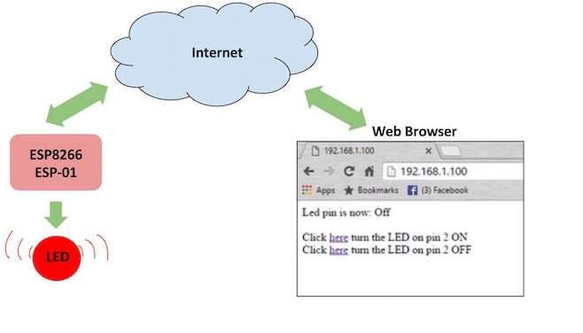
ESP8266

Slide 43
Self contained SOC with integrated TCP/IP
protocol.
1mb flash memory.
Integrated TR switch, balun, LNA, power
amplifier and matching network.
Integrated PLL, regulators, and power
management units.

Slide 44
ADVANTAGES
Adding Convenience to your Daily Life.
Energy efficient
Customization
Ease of Use
Save Money and the Environment
Security

Slide 45
DISADVANTAGES
Equipment and installation costs
System crashes due to any damage in the interconnection
Reliability
Difficult to control different sensors simultaneously.

Slide 46
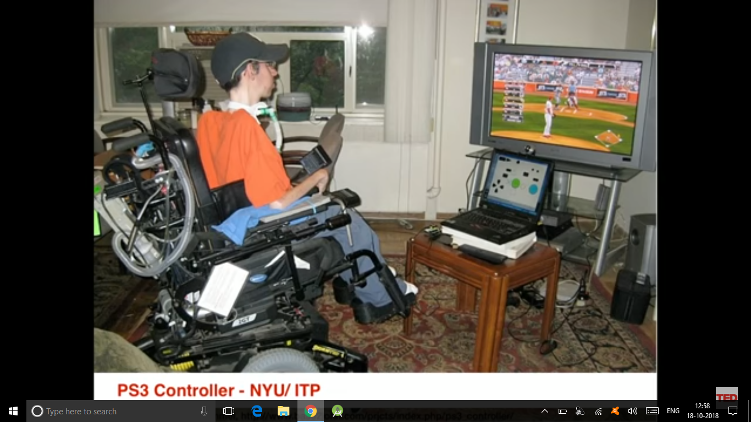

Slide 47
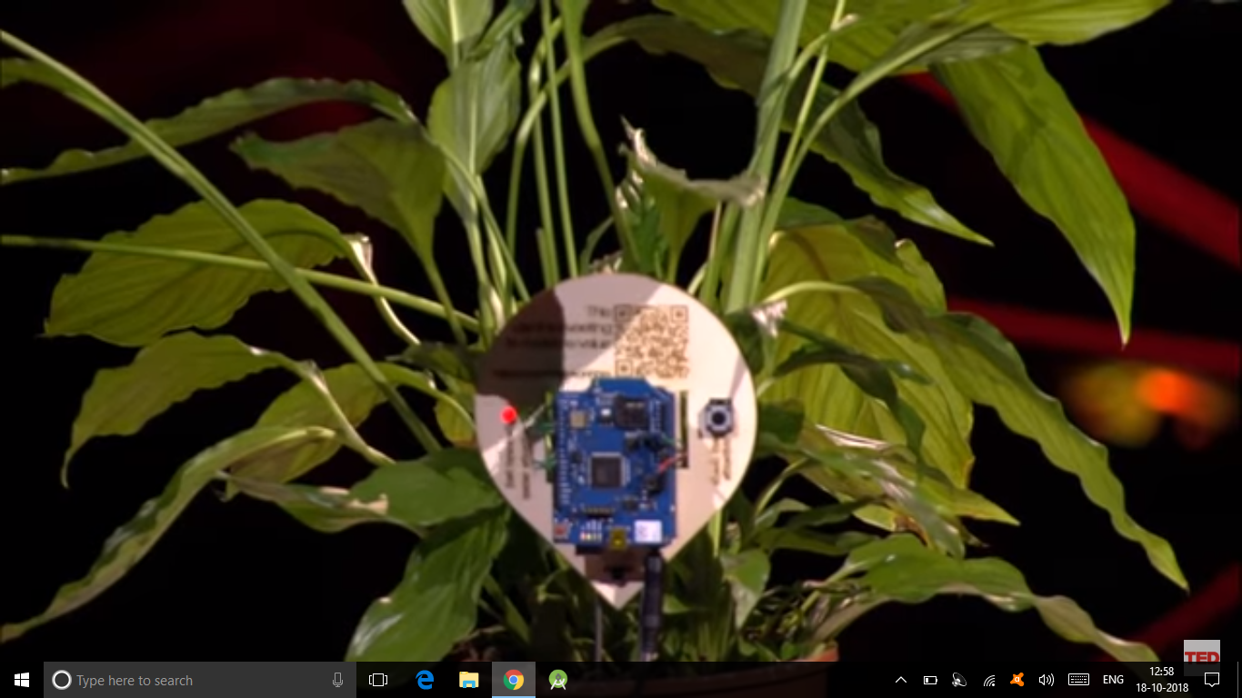

Slide 48
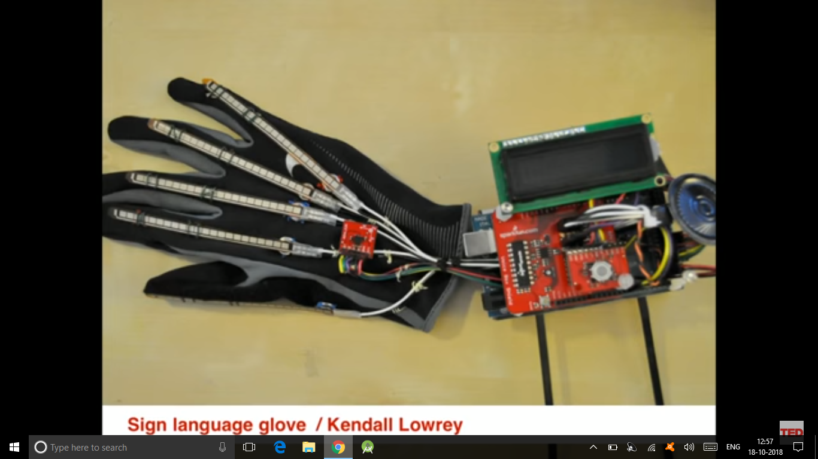

Slide 49
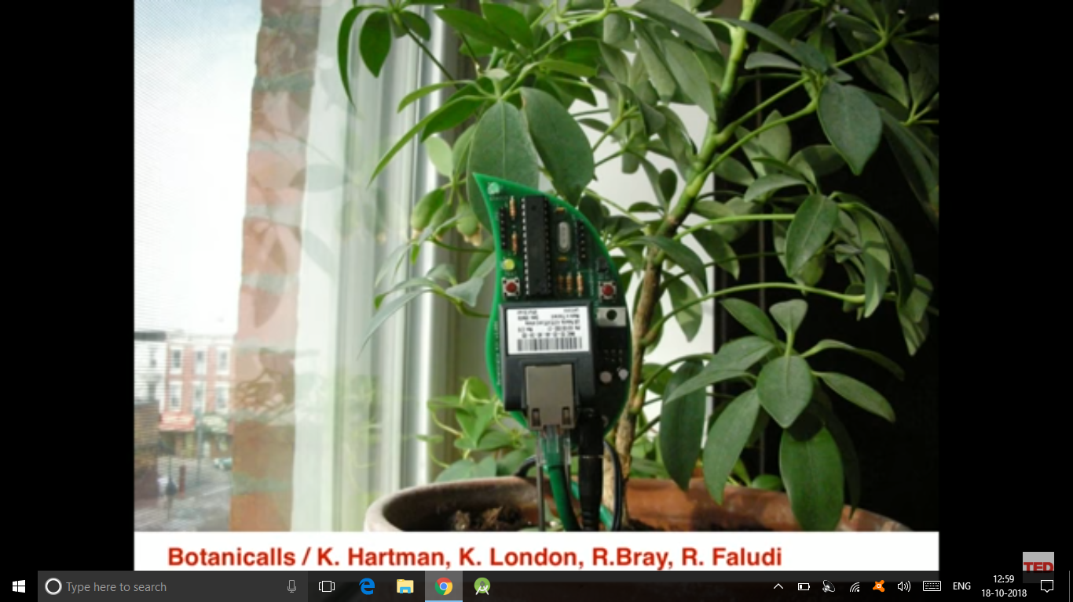

Slide 50
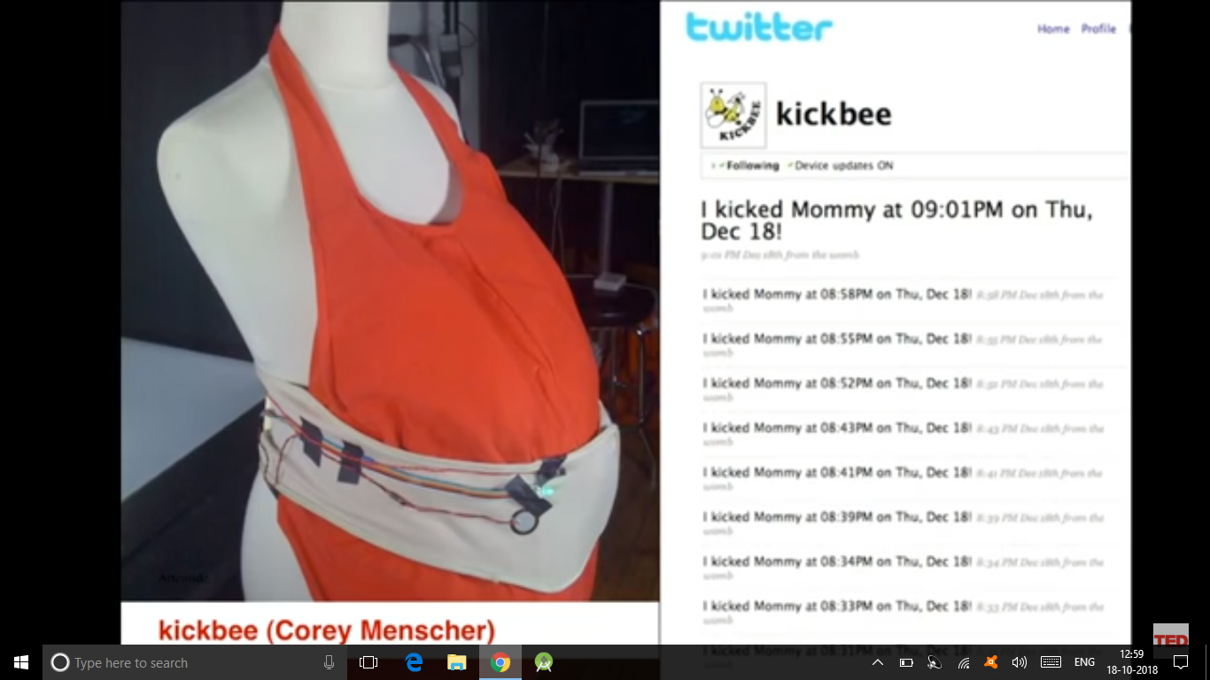

Slide 51
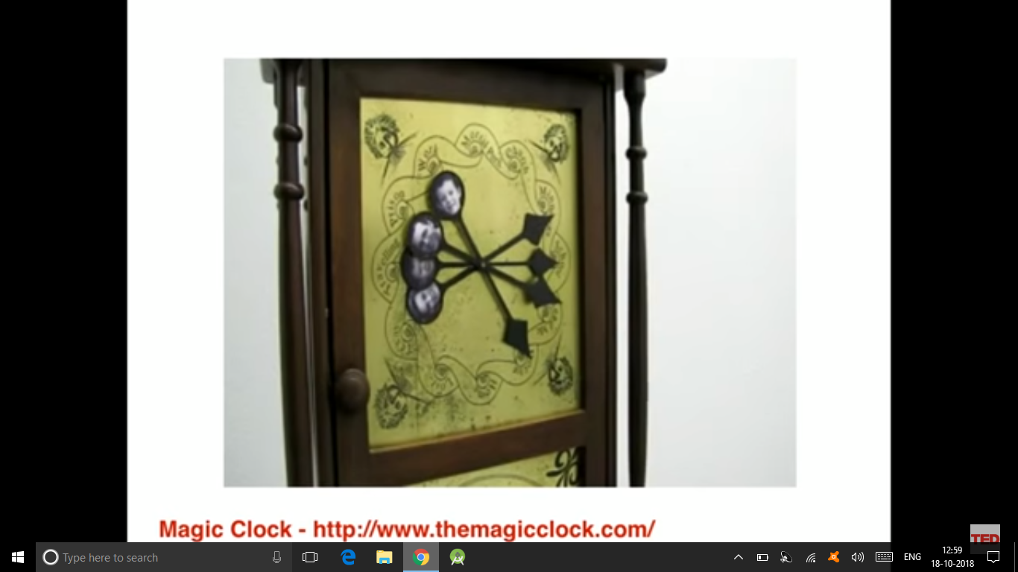

Slide 52
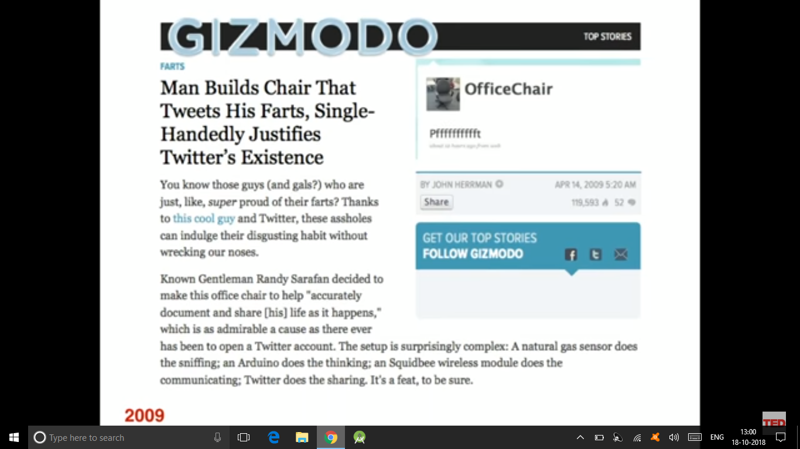

Slide 53
THANK YOU

